Slide 1
CS305: Computer Architecture
Branch Prediction
https://www.cse.iitb.ac.in/~biswa/courses/CS305/main.html

Slide 2
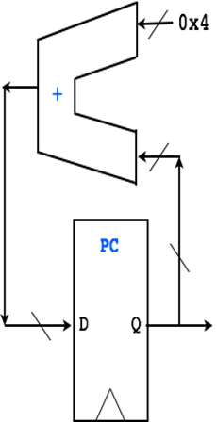




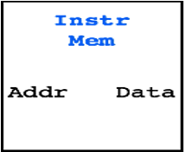
Branch instructions
IF (Fetch)
ID (Decode)
EX (ALU)
MEM
WB
I-Mem
Time:
t1
t2
t3
t4
t5
t6
t7
t8
Inst
EX stage computes if branch is taken
I1:
IF
ID
EX
MEM
WB
I2:
IF
ID
I3:
IF
I4:
If branch is taken, these instructions MUST NOT complete!
I5:
I6:

Slide 3
Branch Predictors
IF (Fetch)
ID (Decode)
EX (ALU)
MEM
WB
I-Mem
Branch Predictor
Time:
t1
t2
t3
t4
t5
t6
t7
t8
Inst
EX stage computes if branch is taken
Predictions
I1:
IF
ID
EX
MEM
WB
I2:
IF
ID
A control instr?
I3:
IF
I4:
Taken or Not Taken?
If taken, where to? What PC?
If branch is taken, these instructions MUST NOT complete!
I5:
I6:

Slide 4
A quick recap
What if PC=PC+4? Not TRUE
Flush/kill all the instructions in the wrong path.

Slide 5
Branch Prediction: 10K Feet View
Predict whether the next PC is a branch PC, at the fetch stage?

Slide 6
Branch Prediction: 10K Feet View
Predict whether the next PC is a branch PC, at the fetch stage?
If branch, will it be taken?

Slide 7
Branch Prediction: 10K Feet View
Predict whether the next PC is a branch PC, at the fetch stage?
If branch, will it be taken?
If taken, what is the target address?

Slide 8
Branch Prediction: 10K Feet View
Predict whether the next PC is a branch PC, at the fetch stage?
If branch, will it be taken?
If taken, what is the target address?
How?

Slide 9
Branch Prediction: 10K Feet View
Predict whether the next PC is a branch PC, at the fetch stage?
If branch, will it be taken?
If taken, what is the target address?
How?
We know whether it is a branch PC or not in the decode stage. Oh no ☹

Slide 10
Branch Predictor: A bit deeper
Three tasks
Is the PC a branch/jump? YES/NO
If Yes, can we predict the direction? Taken or not-taken
If taken, can we predict the target address?

Slide 11
Let’s see
Program
Counter
Address of the
current branch

Slide 12
Let’s see
Direction predictor
taken?
PC + 4
Next Fetch
Address
Program
Counter
Address of the
current branch

Slide 13
Let’s see
Direction predictor
taken?
PC + 4
Next Fetch
Address
Program
Counter
hit?
Address of the
current branch
target address
Repository of Target Addresses (BTB: Branch Target Buffer)

Slide 14
Static (compiler) Direction Prediction Techniques
Always not-taken: Simple to implement: no need for BTB,
no direction prediction
Low accuracy: ~30-40%
Always taken: No direction prediction, we need BTB though
Better accuracy: ~60-70%
Backward branches (i.e., loop branches) are usually taken

Slide 15
Dynamic Predictors
Microarchitectural way of predicting it.
Simple one: Last time predictor

Slide 16
Last-time predictor
predict
not
taken
predict
taken
actually
not taken
actually
taken

Slide 17
Last-time predictor
actually
taken
predict
not
taken
predict
taken
actually
not taken
actually
taken
actually
not taken

Slide 18
Implementation
K bits of branch instruction address
Index

Slide 19
Implementation
Branch history table of 2^{K} entries, 1 bit per entry
K bits of branch instruction address
Index

Slide 20
Implementation
Branch history table of 2^{K} entries, 1 bit per entry
K bits of branch instruction address
Index
Use this entry to predict this branch:
0: predict not taken
1: predict taken

Slide 21
Performance of Last-time predictor
TTTTTTTTTTNNNNNNNNNN - 90% accuracy
Always mispredicts the last iteration and the first iteration of a loop branch
Accuracy for a loop with N iterations = (N-2)/N
+ Loop branches for loops with large number of iterations
-- Loop branches for loops will small number of iterations

Slide 22
Performance contd.
TNTNTNTNTNTNTNTNTNTN → 0% accuracy
20% of all instructions are branches, 85% accuracy
Last-time predictor CPI =
[ 1 + (0.20*0.15) * 2 ] =
1.06

Slide 23
2-bit Predictors: A bit better
actually
taken
actually
!taken
“weakly
taken”
“strongly
taken”
pred
taken
pred
taken
actually
taken
actually
taken
actually
!taken
actually
!taken
“strongly
!taken”
pred
!taken
pred
!taken
“weakly
!taken”
actually
!taken
actually
taken

Slide 24
感謝

